Slide 1

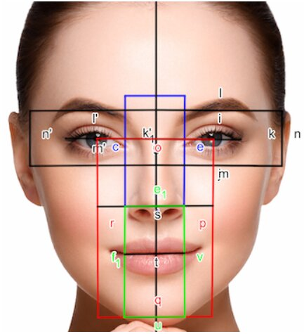
GRFC(Golden Ratio with Face Corelation)
Dept. of Mechatronics
Engineering
Second Year (3rd Semester)
MATLAB Project
Abhishek Sharma - 20BEM1024
Bhajneet Singh Bedi - 20BEM1050

Slide 2

Abstract
The Golden Ratio with face correlation (GRFC) is a code-based MATLAB system based on image processing process.
It basically reads the image weather taken by webcam, wireless mobile cam or rather uploaded.
Our aim is not to hurt anyone feelings and tell the imperfections in his/her face our main aim is to provide this system to beauticians that will use this to cover up the imperfections in one's face.
The beautician will first upload the image and define the specific distance on the face as defined in methodology and the program will calculate the ratio.
The beautician will know what all to cover to give a perfect face.

